Slide 1
PRDA – 01
Profit Analysis
My analysis of startup spending and profit
Priyadharshan R

Slide 2
What I was asked to find
I had to check how R&D, Administration and Marketing spending are related to Profit.
I also had to build a regression model and use it to predict Profit for 2 new startup inputs.
Finally, I had to put the results into Power BI and give business-level insights.

Slide 3
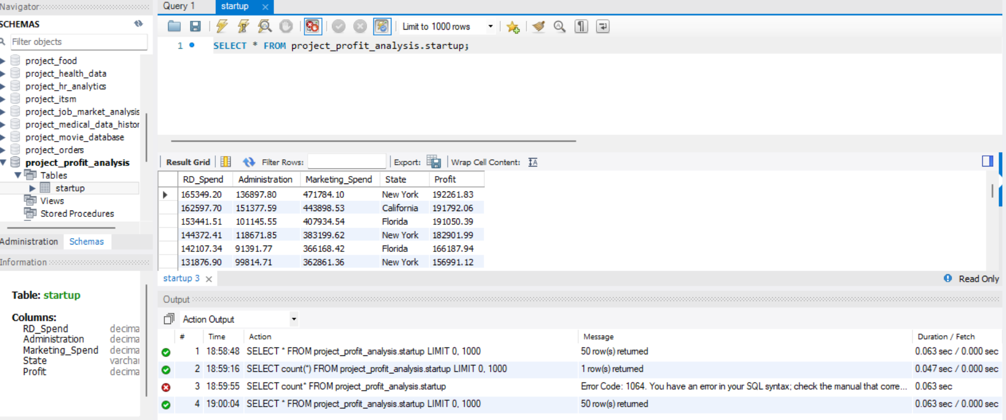
1. Getting the data from SQL
The data came from the startup table in the project_profit_analysis database.

Slide 4
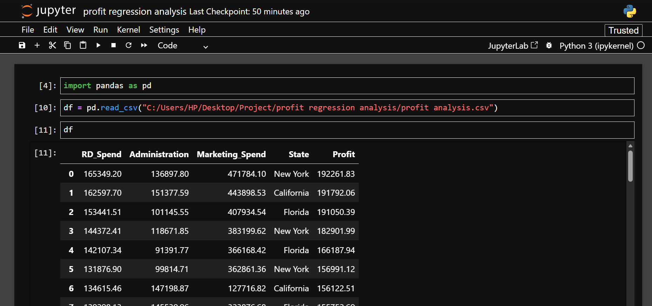
2. Loading the data into Python
I exported the SQL data to CSV and used it in Python for the regression work.

Slide 5
3. Regression setup
I used R&D Spend, Administration and Marketing Spend as X values.
Profit was used as the Y value.
I split the data into 80% for training and 20% for testing.
Then I trained a Linear Regression model and tested it on the remaining data.

Slide 6
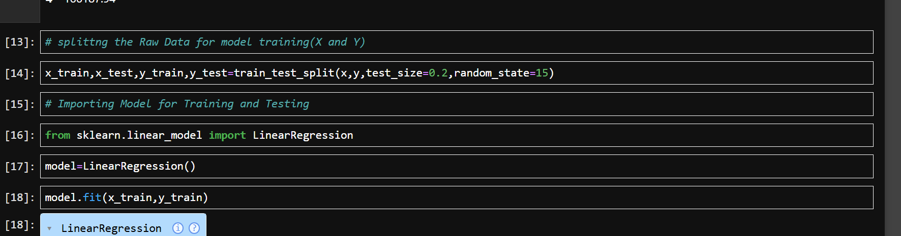
4. Training the model
The model was trained in Jupyter using LinearRegression.

Slide 7
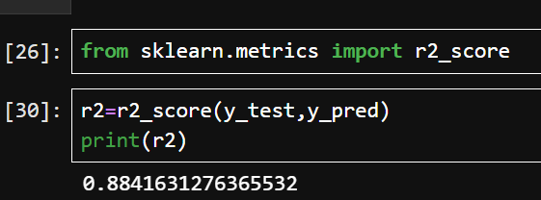
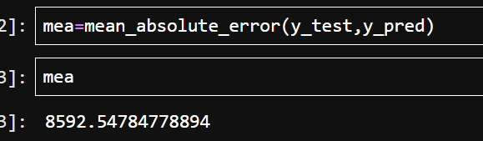
5. Checking the model
R² = 0.884
MAE = 8,592.55

Slide 8
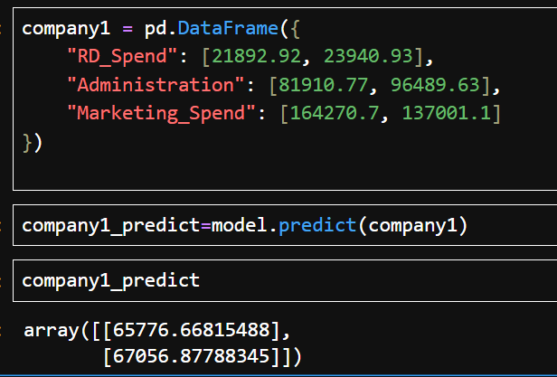
6. Predicting Profit for 2 new startups
Startup 1 → 65,776.67 | Startup 2 → 67,056.88

Slide 9
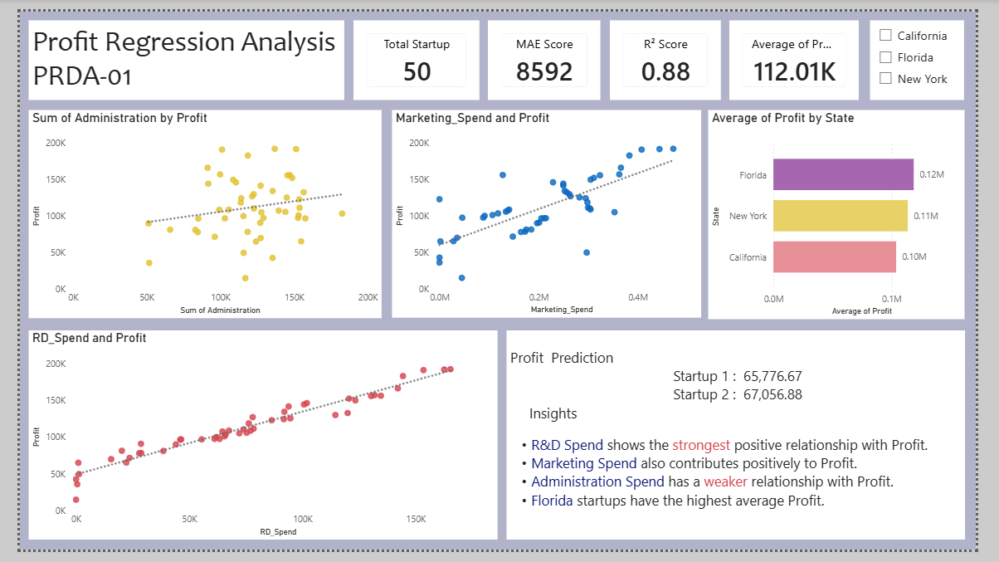
7. Power BI dashboard

Slide 10
What I found from the analysis
R&D Spend has the strongest positive relationship with Profit in my model.
Marketing Spend also moves positively with Profit.
Administration Spend has a weaker relationship with Profit compared with R&D and Marketing.
In my Power BI dashboard, Florida has the highest average Profit among the three states.
Marketing is the largest average spending category in the dataset.

Slide 11
What I would suggest to the company
Keep R&D as an important investment area, especially when the spending is linked to useful products or improvements.
Do not look at Marketing spending only as a big number. Check whether the spending is actually bringing better returns.
Keep Administration costs under control because the analysis shows a weaker link with Profit.
Before making a large investment, use the regression model to compare different spending combinations and expected Profit.
Use these results as a guide for decisions, not as a guarantee of future Profit.

Slide 12
My conclusion
The project helped me go from SQL data to Python analysis and then to a Power BI dashboard.
The model gave an R² of 0.884 and an MAE of about 8,592.55.
I used the model to predict Profit for 2 new startups.
The main point from the analysis is that R&D has the strongest positive relationship with Profit, while Administration has a weaker relationship.
The final result is not just the model — it is using the numbers to understand where the company should focus its spending.

